Slide 1

CS47: Cross-Platform Mobile Development
Lecture 7A: Nested Navigation (+ navigation exercise)
Faculty Advisor
Instructor #1
Fall 2019
https://class.website
class.slack.com
Notes:
This lecture show nested navigation. It is important for students to see this in action before applying it

Slide 2

Overview for today
Authentication Flow Overview
Nested Navigation
We will be working on an in-class project!
Groups of 2, some of 3
Notes:
Introduce today’s topics
[5 mins] Go to the authentication flow guide and show how it switch navigators work. This shouldn’t take a lot of time, but is a way for students to know how to do onboarding and/or authentication for their apps

Slide 3

Navigation
Tab
Navigator
Drawer
Navigator
Notes:
[5 min] A simple guide through motivation for nested navigation and what it means

Slide 4
Navigation
Tab
Navigator
Drawer
Navigator
Notes:
A simple guide through motivation for nested navigation and what it means

Slide 5
Navigation
Tab
Navigator
+
Stack
Drawer
Navigator
Notes:
A simple guide through motivation for nested navigation and what it means

Slide 6
Navigation
Tab
Navigator
+
Stack
Drawer
Navigator
Notes:
A simple guide through motivation for nested navigation and what it means

Slide 7
Navigation
Tab
Navigator
Drawer
Navigator
Notes:
A simple guide through motivation for nested navigation and what it means

Slide 8
Navigation
Tab
Navigator
Drawer
Navigator
Notes:
A simple guide through motivation for nested navigation and what it means

Slide 9
Navigation
Tab
Navigator
Drawer
Navigator
+ Stack
Notes:
A simple guide through motivation for nested navigation and what it means

Slide 10
What does this look like programmatically?
Notes:
This should take about 10 mins. Compare the non-nested implementation with the nested one

Slide 11
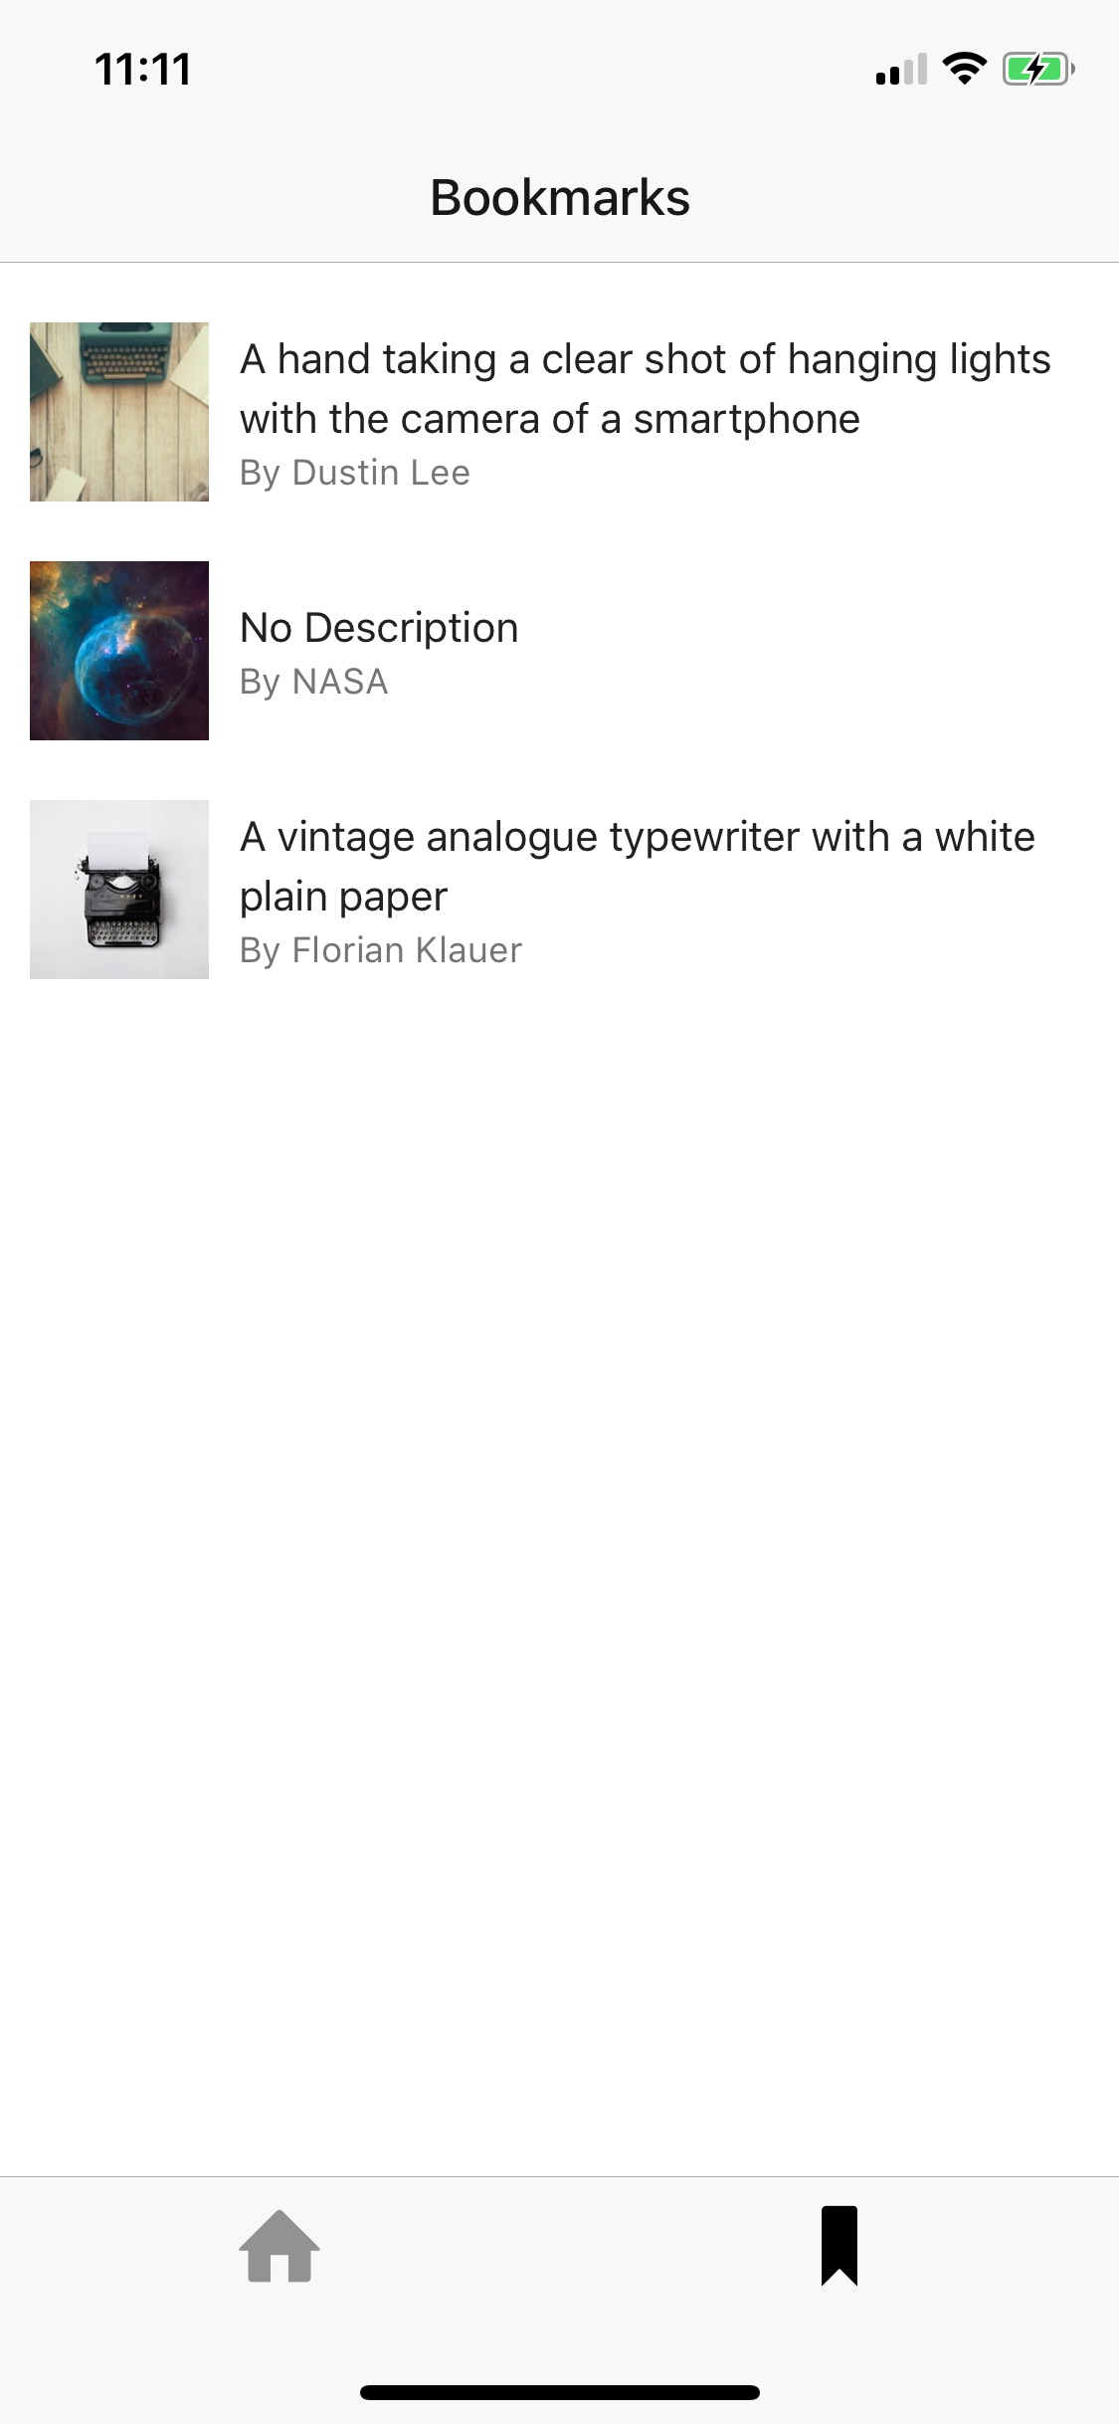
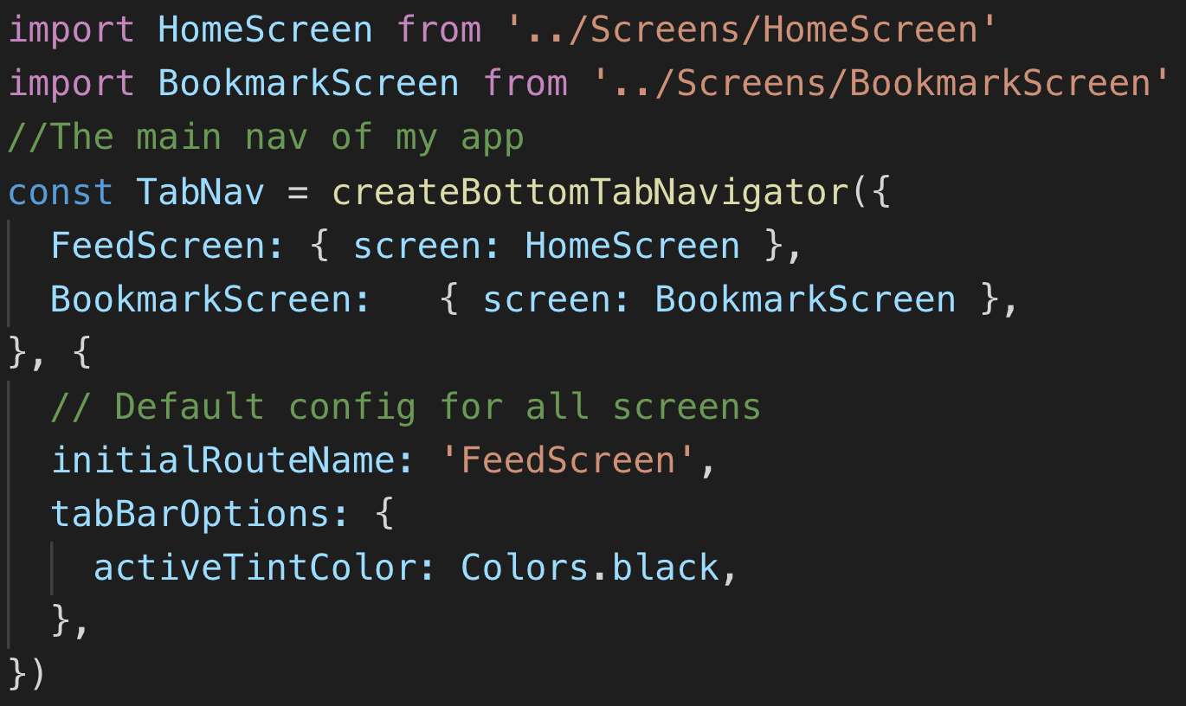
Notes:
We saw similar implementation to this before

Slide 12
¯\_(ツ)_/¯
Notes:
If we click on something, based on our implementation this will only go to another tab or out of the app

Slide 13
¯\_(ツ)_/¯
Notes:
But what we see all over our apps and what we want here is to open just a new screen… in a stack navigator within the bookmarks

Slide 14
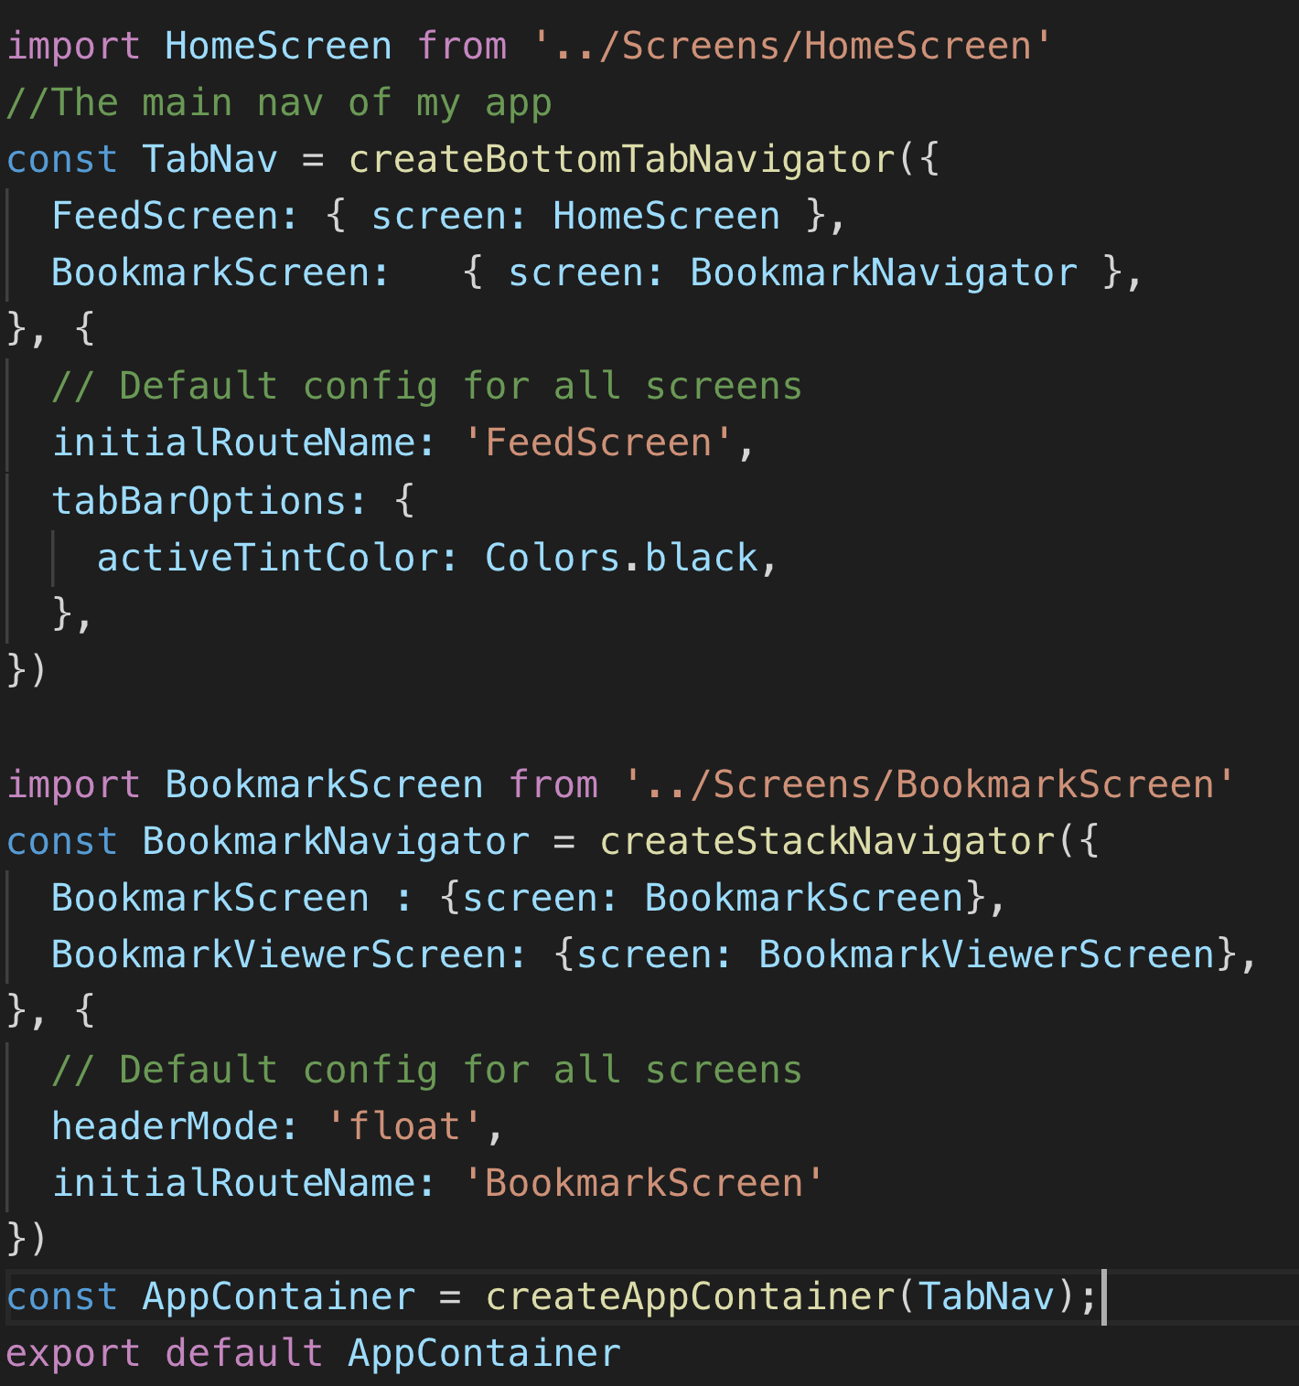
Notes:
This is the transformation we do to get the nested nav

Slide 15
Notes:
If we just wrote this, it will do the same functionality as before, but the single screen will be part of the stack nav

Slide 16
Notes:
What this allows us to do is adding screens

Slide 17
Notes:
Then we export the tab

Slide 18
Demo
https://reflect.sh/thriving-hook
Notes:
Change link based on your demo

Slide 19
Exercise
Notes:
This should take about 30-40 mins for the main parts
20-30 for the remaining 2 parts

Slide 20
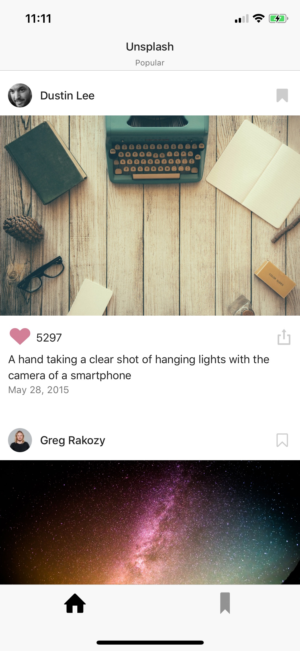
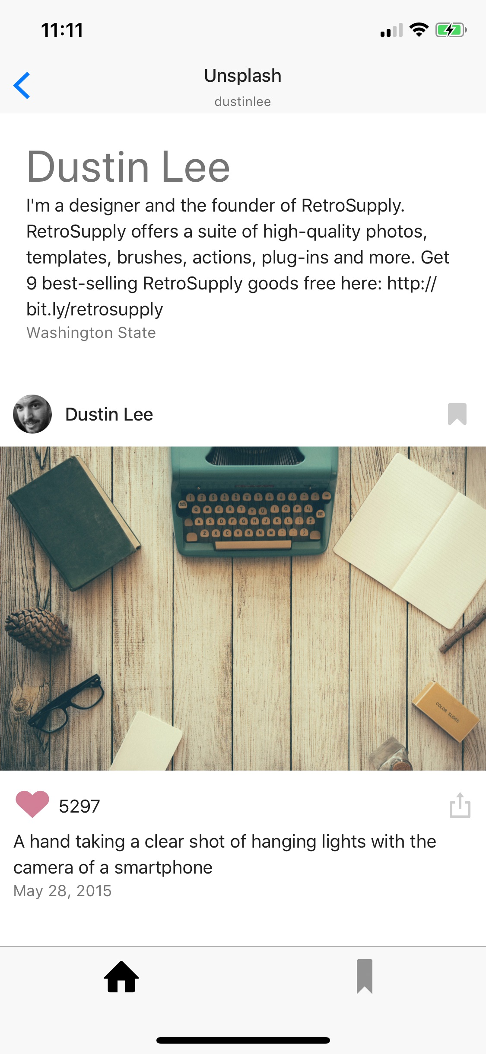
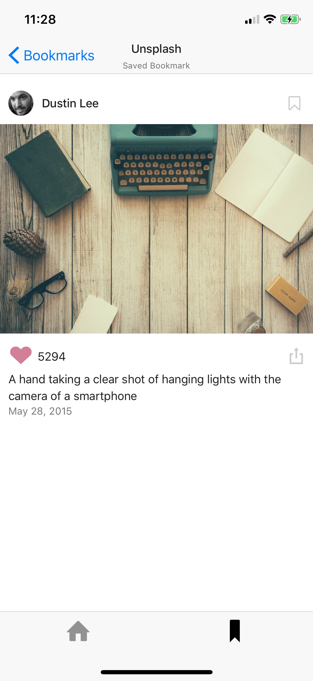

Slide 21
Roadmap
Implement a FlatList using server data
We want to be able to tap on a FlatList element and navigate somewhere else...
Implement Nested Navigation.
Implement the navigate() function.
If time allows, we’ll then make things look prettier.
If time allows, we will implement bookmark functionality!

Slide 22
Groups of 2, or 3.
Follow these slides as guidance.
Don’t move on to next step until everyone in the group has finished the step.
Starter Code: https://github.com/stanford-cs47/React-Native-Demos/tree/master/content/13-Lecture7A-Starter
Notes:
#1, 2, 3

Slide 23
Step 0.5: note that the App.js renders a TabNavigator. The main tab shown is HomeScreen.js
Step 1: start with the Feed.js file, which is what HomeScreen.js renders
Comment in the “this.getFeedData()” method in componentDidMount
Go to the getTabContent() function and follow the steps in the comments.
Go to onProfilePressed and follow the comments.
Before moving on, make sure that everyone in your group has gotten the previous step.
Step 2: go to the AppNavigation.js file
Follow all three steps
Make sure that your code runs
Before moving on, check-in with your group.
Step 3: go back to the HomeScreen.js file
Follow the steps on onProfileRequested()
This relies on your Feed.js implementation. Note how we are passing data back to the screen which is defined in the Navigator — only this screen has access to the navigate() function.
You have now opened a new screen inside of your nested Stack :’)
Live code
https://reflect.sh/overjoyed-basket
Starter Code: https://github.com/stanford-cs47/React-Native-Demos/tree/master/content/13-Lecture7A-Starter

Slide 24
If time allows
Step 4: go back to your Feed.js file
Implement part X in getTabContent(). Use the ListHeaderComponent prop of a FlatList. Pass on to it something to render. The Feed.js has a prop with a view that you should render here.
The BookmarkScreen.js and BookmarkViewerScreen.js is already coded. Let’s hookup some bookmarks!
Before moving on, check-in with your group.
Step 5: go to the FeedItem.js file
Implement the _storeBookmark() and _removeBookmark() functions using AsyncStorage. Your BookmarkScreen.js file will pick up these changes once you refresh.
Starter Code: https://github.com/stanford-cs47/React-Native-Demos/tree/master/content/13-Lecture7A-Starter

Slide 25
CS47: Cross-Platform Mobile Development
Lecture 7A: Nested Navigation (+ navigation exercise)
Faculty Advisor
Instructor #1
Fall 2019
https://class.website
class.slack.com
Notes:
This lecture show nested navigation. It is important for students to see this in action before applying it

